Slide 1

What’s in the kit…….

Slide 2

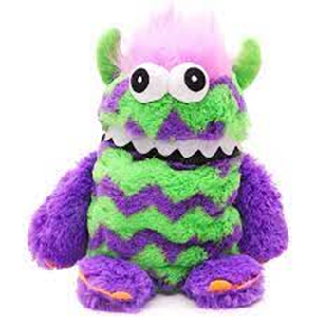
The Worry Monster
Notes:
A worry monster (a soft toy with a zip or mouth for “posting” worries) is a simple, child‑friendly tool that can significantly improve how safe, manageable and participative a Children’s Hearing feels for a child or young person. Used sensitively, it supports emotional safety, communication, regulation and power‑sharing, all of which are core to trauma‑informed practice.
By giving worries to the worry monster the worry becomes something external, not part of the child. The child is not defined by their distress, shame and fear of judgment are reduced.
Before or during the hearing the child can write down any questions, worries of views they want to give the panel. Rather than giving these directly to the panel, they feed the note to the Monster and a professional in the hearing can ensure that they views are discussed in a child centred and trauma informed way.
If what the child has written down is to be given directly to the hearing , then the reporter will approach this in the same way as any other information brought along to be tabled at the hearing.

Slide 3

Mini White Board
Notes:
White Board 6 +
A whiteboard can be a powerful low‑tech, high‑impact tool. Used well, it helps children and young people feel safer, more in control, and more able to understand and participate, especially when emotions run high or language feels overwhelming.
Trauma can affect:
Memory and processing
Attention and comprehension
Ability to speak under pressure
A whiteboard supports trauma‑informed practice by:
Slowing conversations down
Making information visible, predictable, and concrete
Reducing the pressure to rely only on spoken words
Supporting choice, control, and transparency

Slide 4
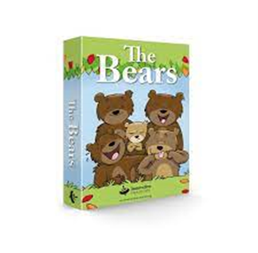
Emotion Cards
Notes:
Emotion Cards 6+
The Bears Emotion Cards are a set of 48 illustrated bear cards designed to help individuals, especially children, explore and communicate their emotions effectively. These cards depict a wide
range of feelings, from joy and excitement to fear and frustration. The Bears are useful for young children; each card has a different emotion included.
How to Use The Bears Emotion Cards
Emotional Check‑In
Ask:
“Pick a bear that shows how you’re feeling right now.”
No explanation is required. The choice alone gives you valuable information.
Talking About Experiences
Prompts can include:
“This bear feels like me when…”
“This bear might need…”
“This bear is feeling this way because…”
Talking about the bear often feels safer than talking about self directly.

Slide 5
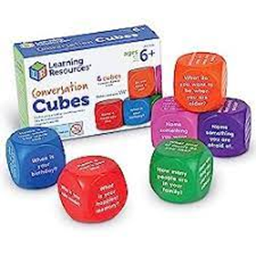
Conversation Cubes
Notes:
Conversation Cubes 6+
Engaging conversation starters to help young people get talking/ice breaker.
There are 36 questions across six colourful cubes.
Conversation cubes are soft or card dice with prompts on each face. When rolled, the prompt guides discussion, reflection, or sharing. They provide a structured but playful way to support communication, participation, and thinking.
They are especially effective for children and young people who may find open‑ended questions difficult.
How to Use
Roll the cube
Read the prompt aloud
Give thinking time
Share in words, drawing, or gesture
Passing is always allowed
Key message: You don’t have to answer every question.

Slide 6
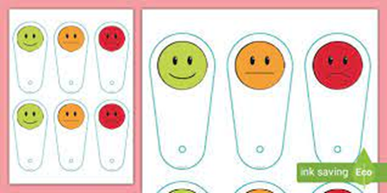
Emotions Fan
Notes:
Communication Fan resources 6 +
A communication fan is a handheld set of cards (joined like a fan) that show words, symbols, pictures, or phrases to help children and young people communicate their needs, feelings, choices, or boundaries — especially when speaking feels difficult.
It supports voice, choice, and participation in a calm, accessible way.
It is good for supporting non‑verbal or reduced‑speech communication, helping children express needs, feelings, and preferences whilst reducing anxiety in meetings or unfamiliar situations.
How to use the fan
Invite the child to:
“Show me a card that fits how you’re feeling right now.”
OR
Place the fan in front of the child Pause regularly and let them select a card Watch for non‑verbal cues alongside card choices

Slide 7
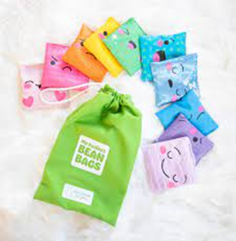
My Feelings Bean Bags
Notes:
Emotion bean bags are small, soft bean bags with an emotion word, face, or symbol on each one. They help children and young people identify, express, and talk about feelings in a hands‑on, playful way. They’re especially useful where talking directly about emotions can feel hard and great for encouraging participation or giving children a non-verbal way to communicate as well as supporting self-regulation.
How to Use Emotion Bean Bags
Check‑In Activity
Ask:
“Pick a bean bag that shows how you’re feeling right now.”
Optional follow‑up: “What made you feel that way?”
No pressure to explain — the choice itself is communication.
Talking About Situations
Throw or pass the bean bag and answer:
“I feel [emotion] when…”
“Something that helps when I feel [emotion] is…”

Slide 8
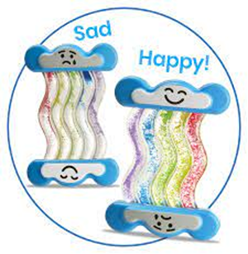
Feelings Rainbow
Notes:
My Feelings Rainbow is a visual and reflective tool that helps children and young people notice, name, and express a range of emotions rather than feeling they must choose just one. It supports the understanding that it’s normal to feel more than one thing at the same time.
How to Use My Feelings Rainbow
Emotional Check‑In
Ask gently:
“Can you show me how you’re feeling today on the rainbow?”
The child might choose only one colour or several colours or just point and hover
The my feelings rainbow supports emotional expression without talking reducing pressure to explain.
Acknowledging Mixed Feelings
Use language like:
“It looks like you’re feeling worried and hopeful.”
This helps children feel:
Understood
Normal
Less confused by conflicting emotions
This is especially important in Hearings, where feelings are rarely simple.
Supporting Regulation
Ask:
“Which feeling feels strongest?”
“Which feeling would you like help with?”
This helps adults respond to real needs, not assumptions.

Slide 9
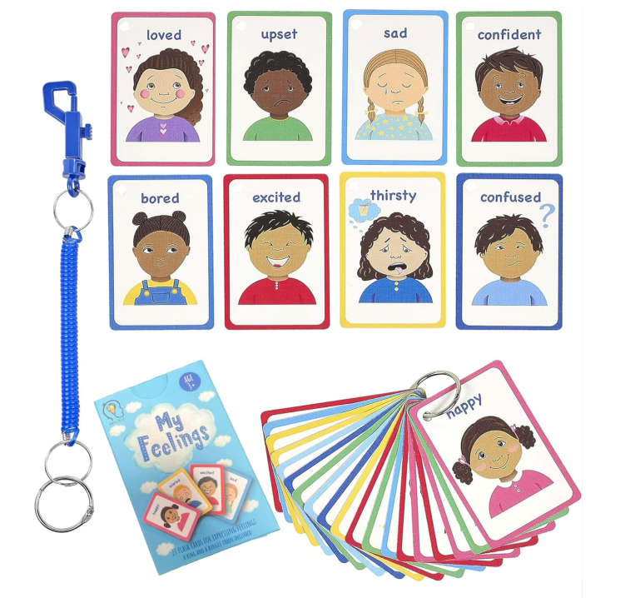
My Feelings Cards
Notes:
My Feelings Cards are a set of simple cards showing emotions through words and faces. They are designed to help children and young people identify, express, and communicate feelings safely, especially when speaking feels difficult.
How to Use My Feelings Cards
Emotional Check‑In
Invite the child to choose one or more cards:
“Can you pick a card that shows how you’re feeling right now?”
No explanation is required.
Reduces pressure
Respects non‑verbal communication
Acknowledging Mixed Feelings
Children can select:
More than one card or cards that feel contradictory
When responding, try to use reflective language to help the child feel understood and less confused about their emotions
“It looks like you’re feeling worried and hopeful at the same time.”
Talking About Experiences
How do you feel when you have contact with……
Can you tell me when you feel like this?
Avoid “why” questions.

Slide 10
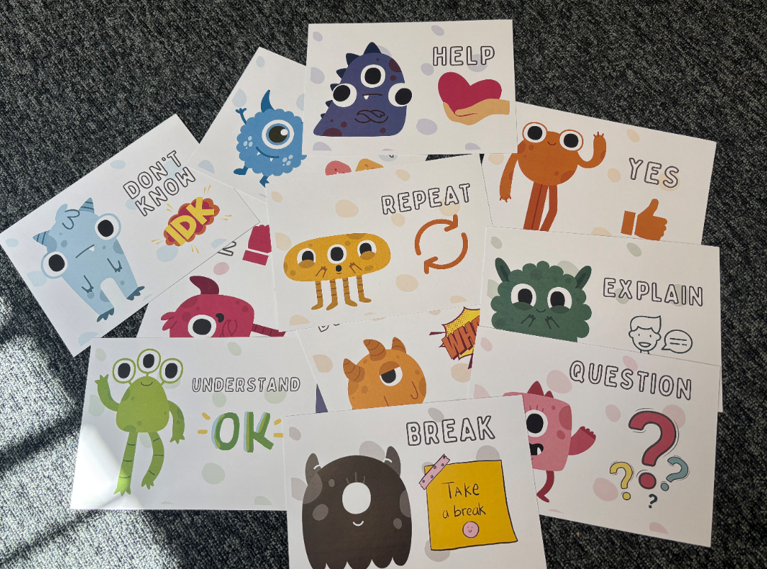
Monster Communication Cards
Notes:
Yes/No/Stop/Go communication cards can be used when young people need a break etc. These are printed and provide internally by the comms team – communications@scra.gov.uk

Slide 11
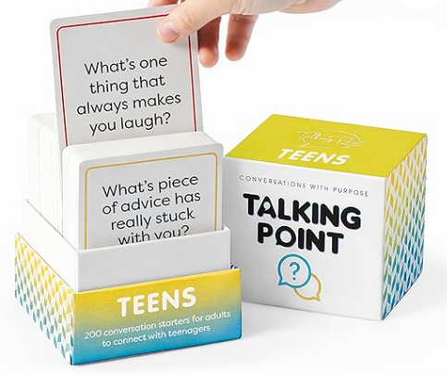
Emotions Cards for Older Young People
Notes:
Talking Point Cards Teens helps you ask great questions to break the ice through relationship-building conversation.
The pack, tailored for teens has 5 great categories: ‘Relationships’, ‘Personal Well Being’, ‘Tough Topics’, ‘Future’, and ‘Fun & Random’ are each expertly written just for a teenagers phase of life. So grab a card, ask the question and listen, these are a great ice breaker.

Slide 12
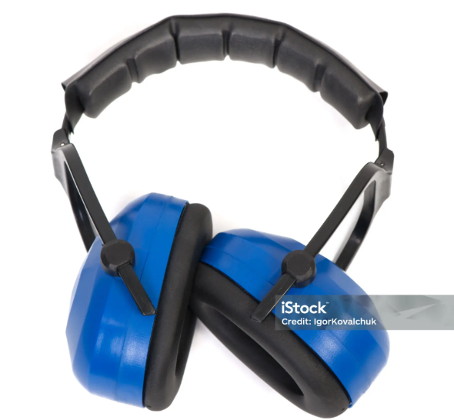

Ear Defenders and Sunglasses
Notes:
Benefits of Ear Defenders and Sunglasses for Neurodivergent Young People
Many neurodivergent young people (including autistic children, those with ADHD, sensory processing differences, or trauma histories) experience the world more intensely through their senses. Ear defenders and sunglasses are simple, practical tools that can make a significant positive difference.
Benefits of Ear Defenders
Ear defenders help reduce auditory overload, help young people feel calmer and more regulated, support concentration and engagement, reduce anxiety and the risk of going into the red or blue zone of the window of tolerance whilst giving the young person a sense of control and predictability
Benefits of Sunglasses
Sunglasses help manage visual sensory overload, helping young people feel safer and less overwhelmed, support emotional regulation and participation.
Using ear defenders or sunglasses can also:
Increase a young person’s confidence
Support self‑advocacy (“this helps me cope”)
Reduce feelings of being judged or misunderstood
Demonstrate that adults are listening and adapting

Slide 13
Trauma Informed Practice Tips
Avoid “why?” questions
Validate feelings: “That makes sense.”
Let children play with the tools rather than speak
Watch body language
Always allow a pass
Validate all responses
Avoid “why?” questions — use supportive prompts instead
Always offer, never insist
Let children change their mind
Accept silence as communication
Avoid labelling or interpreting without checking
Normalise all emotions

Slide 14
Trauma Informed Practice Tips
Let children show, not tell
Avoid “why?” questions — use “what happened?” or “tell me about…”
Validate all emotions: “That makes sense.”
Be mindful that some emotions may link to difficult experiences
Communicate to children and young people that your feelings matter, even if you can’t explain them.”

Slide 15
Trauma Informed Benefits of Non-Verbal Communication
Reduces reliance on verbal explanation
Supports children whose brains are in survival mode
Validates emotions without needing justification
Reinforces that feelings are information, not behaviour
Help children remain within the window of tolerance

